Slide 1
aCGH-based CNV analysis on NCI-60 cell lines
What do we read ?

Slide 2
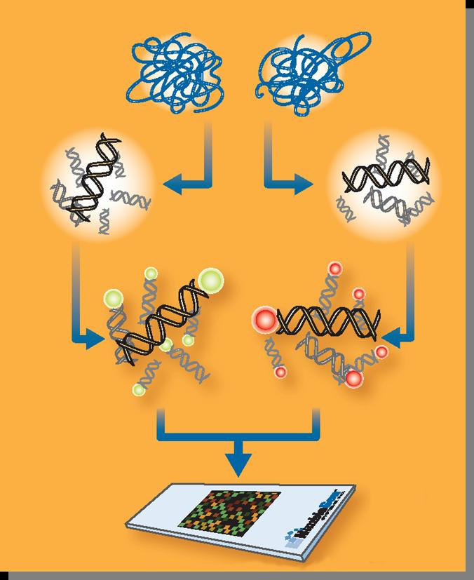
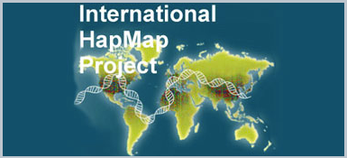
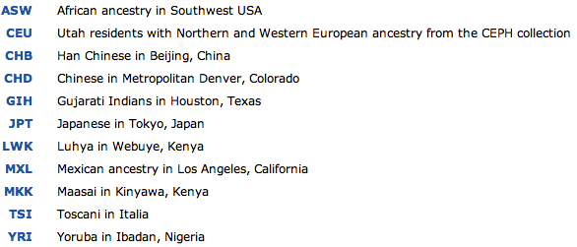
aCGH analysis : signal comparison (Log₂(ratio)), relative to a reference.
Direct dual color hybridization
(competitive hybridization)
Agilent, Nimblegen
Indirect comparison (Hapmap270)
(post-hybridization computation)
Affymetrix

Slide 3
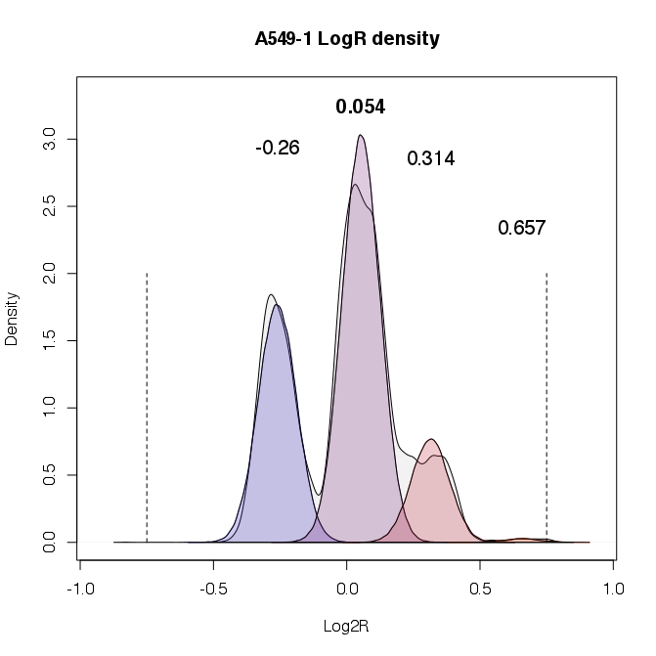
A key step : the centralization of Log₂(ratio)
Loss
Gain

Slide 4
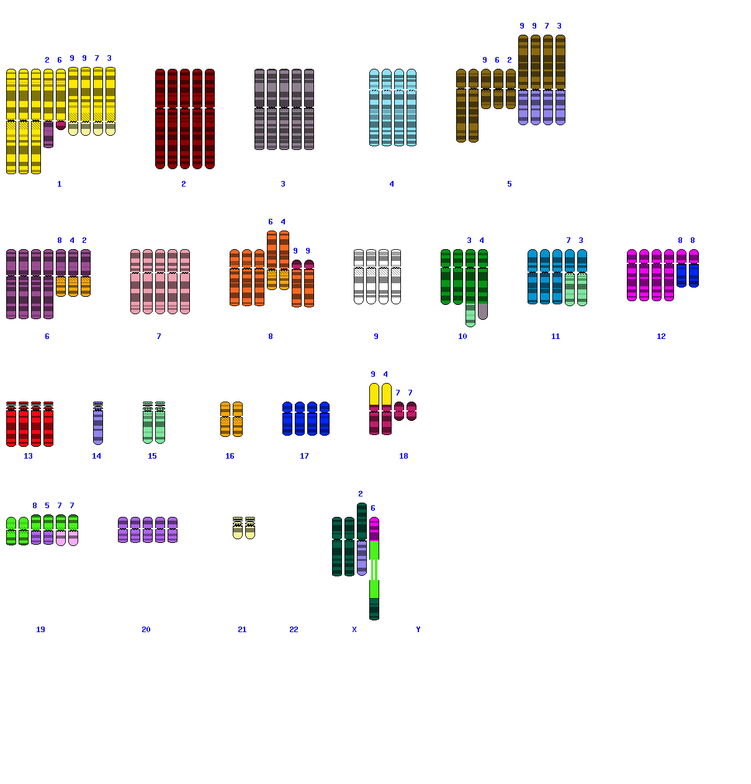

From NCI60 cell lines panel
HOP-62 (lung cell line) karyotype (4n+)

Slide 5
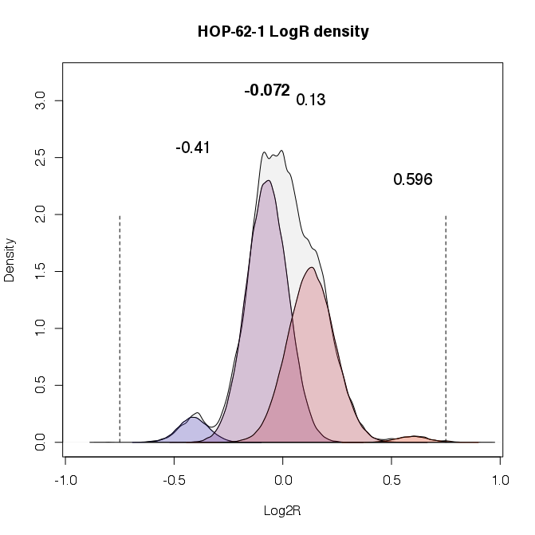
Before centralization
Seeing that HOP-62 is 4n+, and ref is 2n, one would expected a shift to the right.

Slide 6
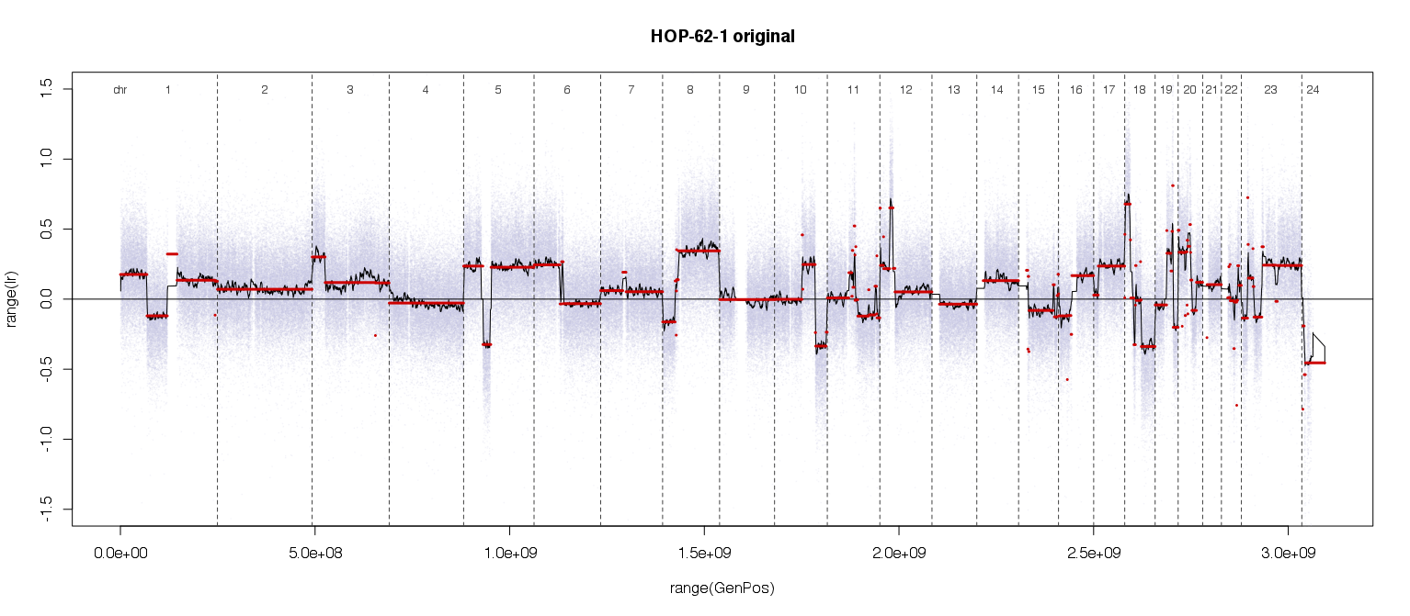
?
?

Slide 7
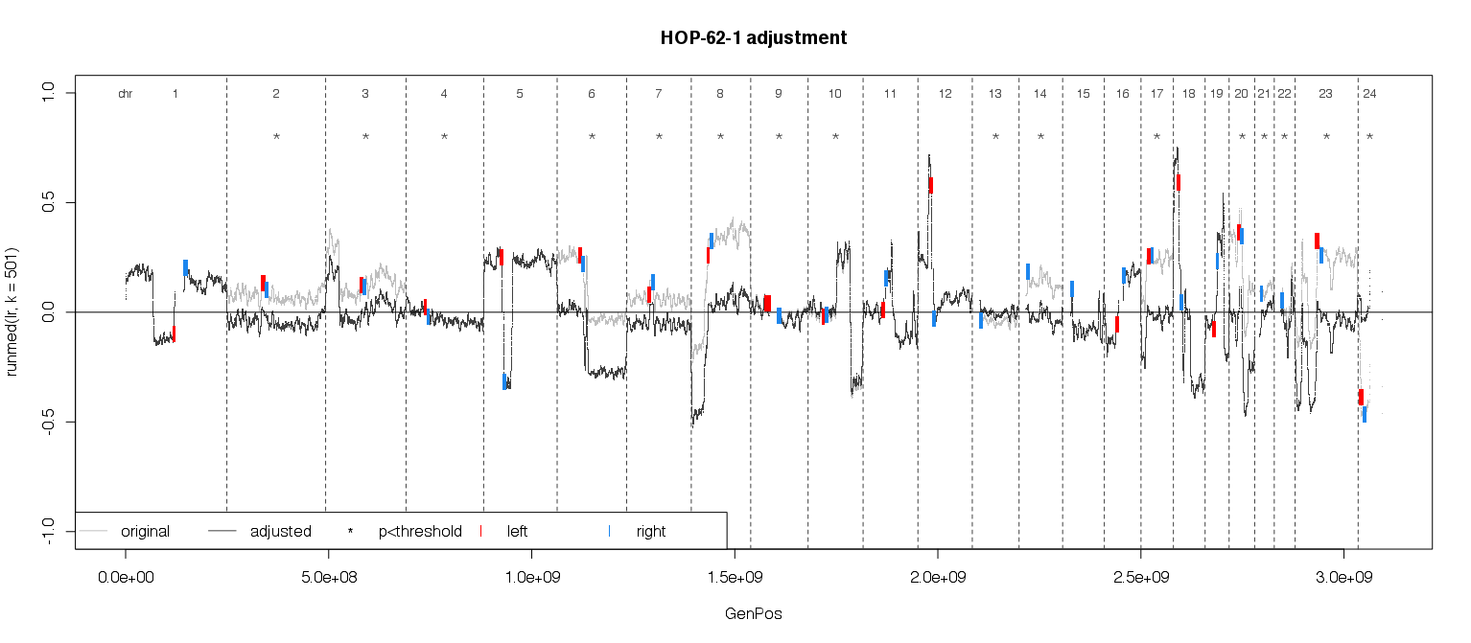
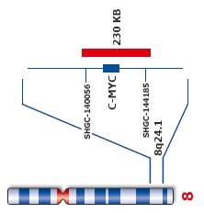
The centromer adjustment method
∝_{L}
∝_{R}
Centromere
neighborhood
Decision rule:

Slide 8
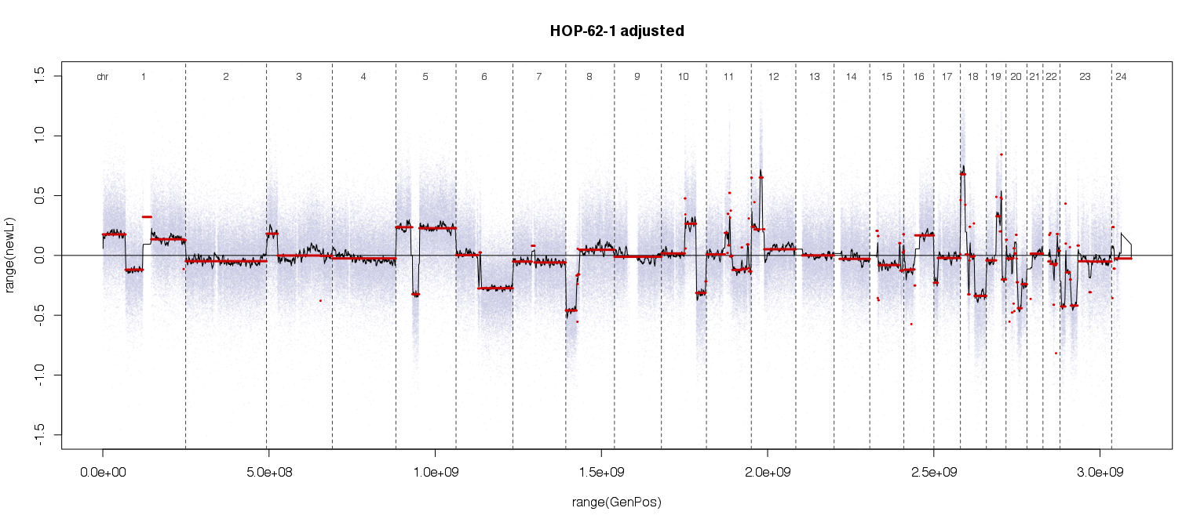
*
*
*
*
*
*
*
*
*
*
*
*
*
*
*
*

Slide 9
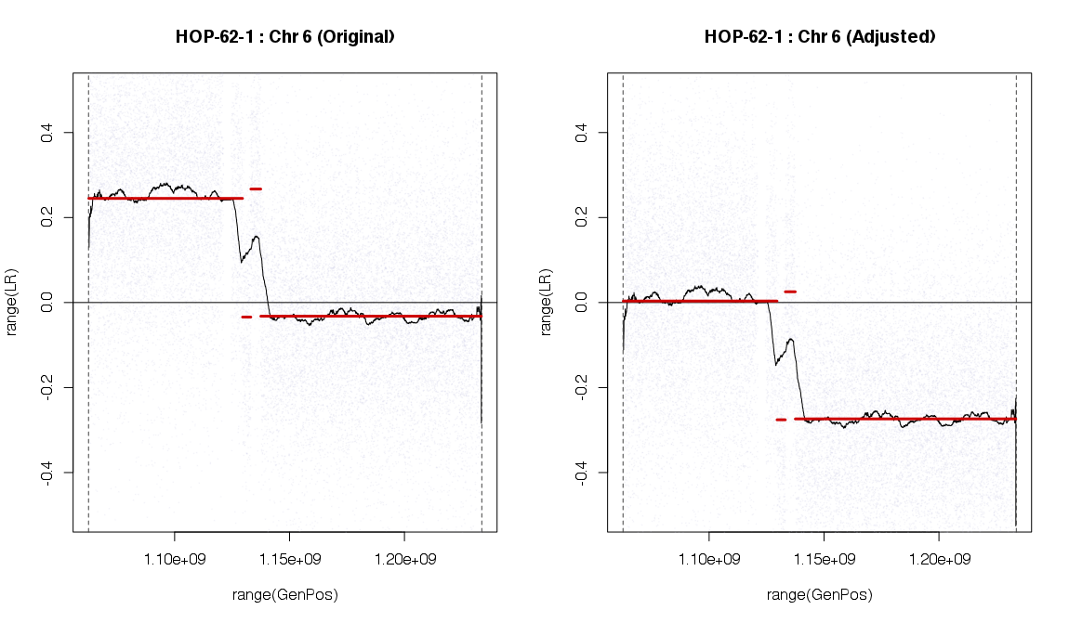
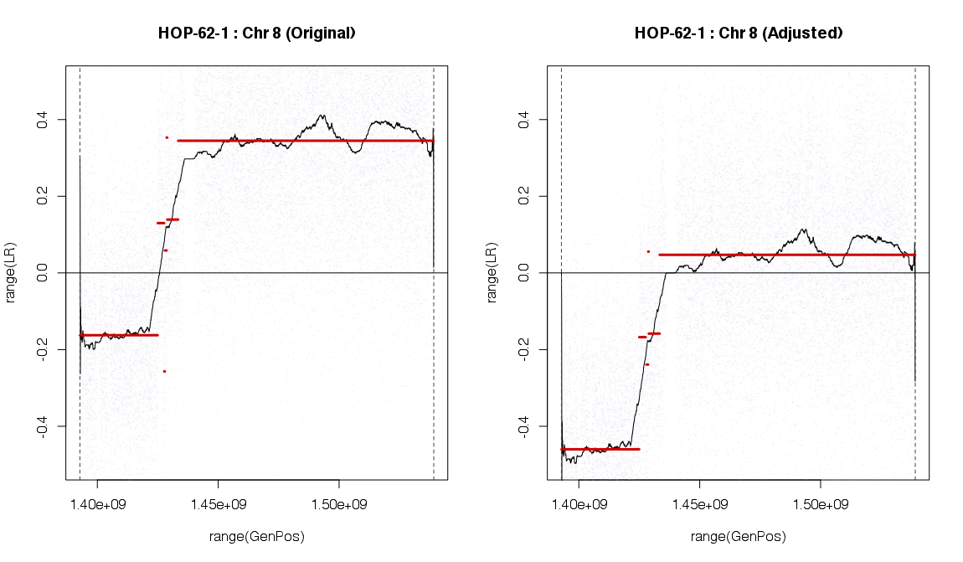
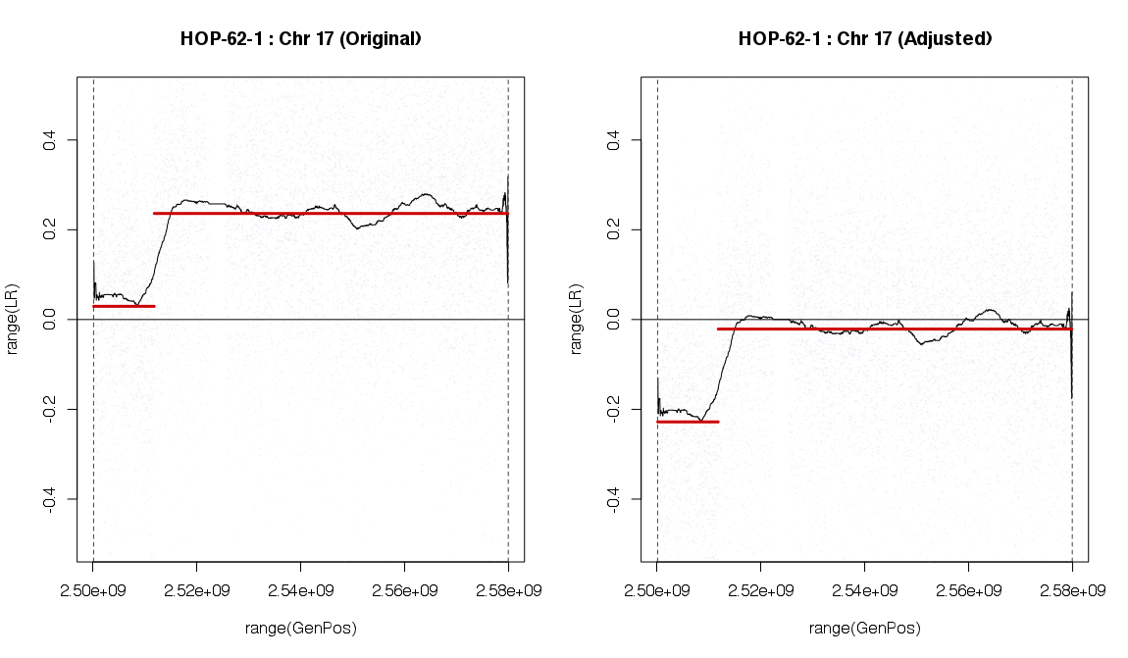
Effect of ‘centromeric’ centralization (HOP-62)
16q
6p
8q
18p
16q
17q

Slide 10
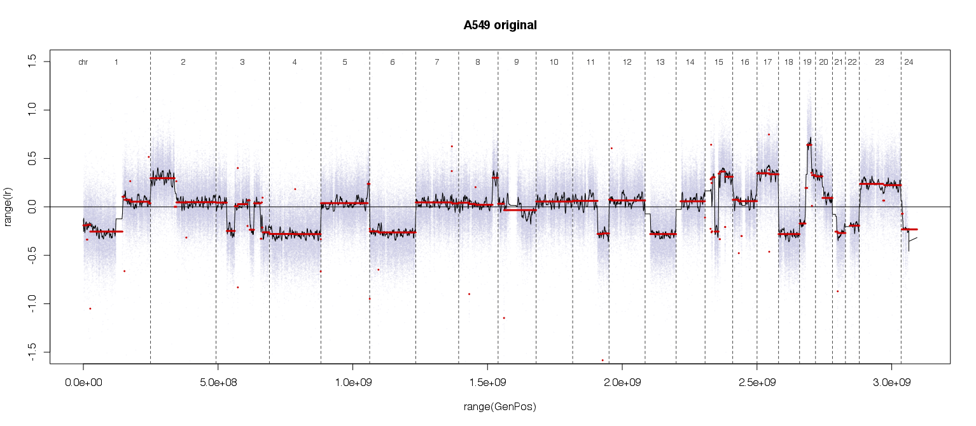
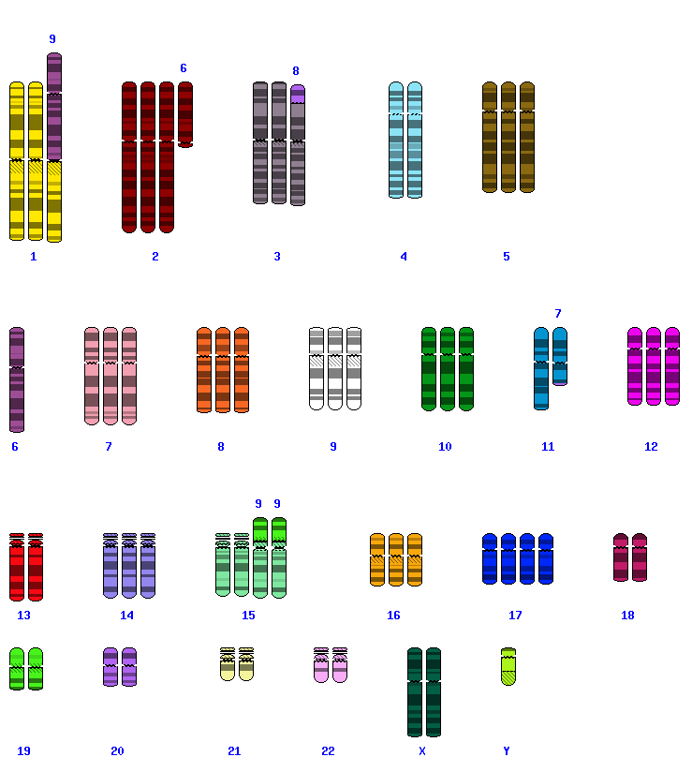
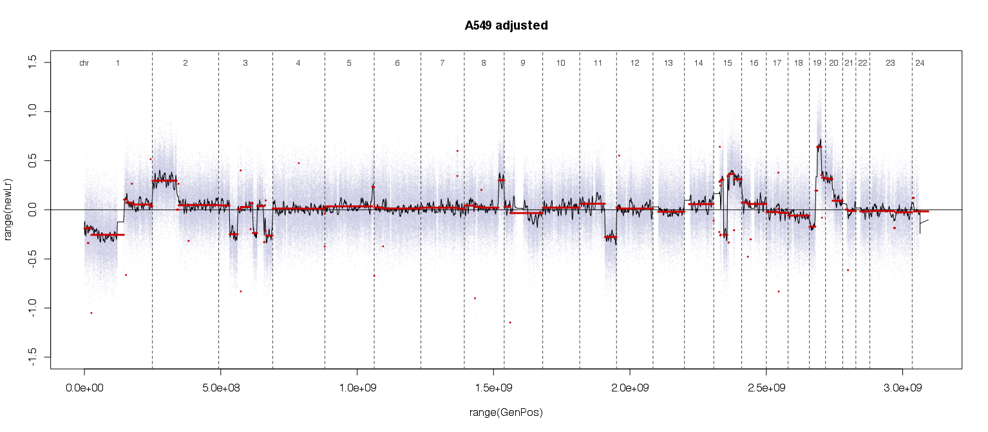
A549 (lung, 3n)

Slide 11
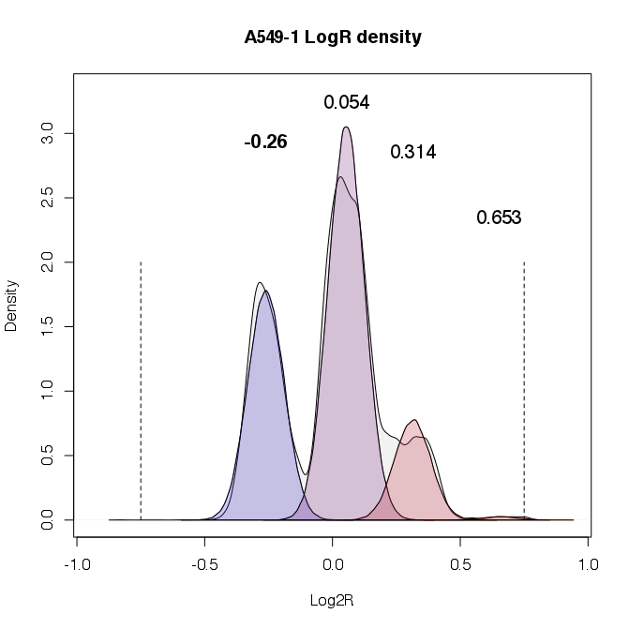

Slide 12
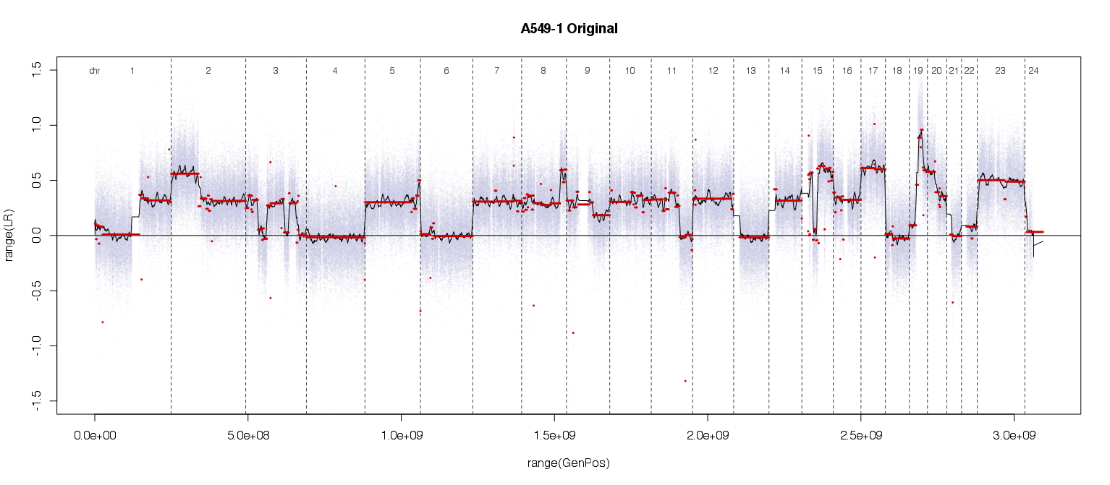
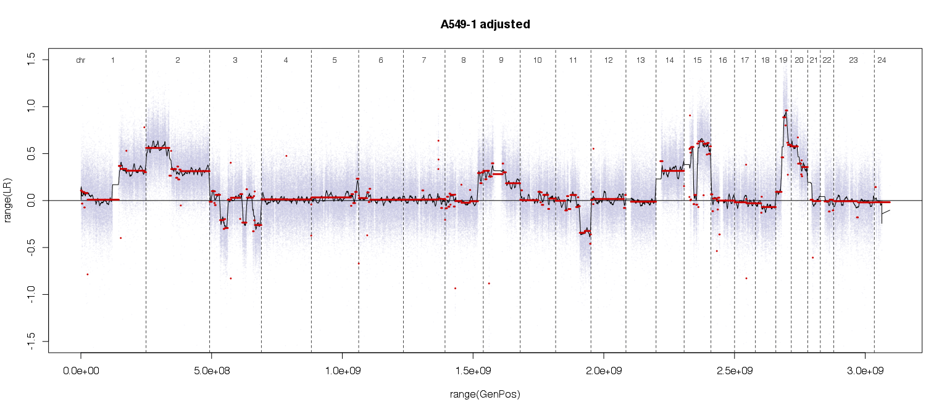

Slide 13
aCGH-based genomic profiles are complex.
On tissues, 2 dilution effects may have an impact on the profile:
The normal tissue.
The tumor heterogeneity
More than the segmentation step, the centralization is crucial.
Due to different full chromosomes imbalances, a global centralization seems to be inappropriate.
Do we have to consider what is gained or what is lost ?

Slide 14
